Slide 1
SEE, HEAR, DO
Scouting – Growing the voice of young people
Presented by Drew Launchbury
SFNI Programme Lead

Slide 2
See, Hear, Do
Scouting Ireland Northern Province Conference 2023
Drawing Conclusions
A quick activity to get us moving and get our minds thinking:
Step 1 – Find a partner
Step 2 – Take a marker & a piece of card (one of each between pairs)
Step 3 – One person take the marker and hold it with the nib facing
downwards – you must stay still and must remain silent.
Step 4 –Your partner must draw or write the word that I will give you.
You have 60seconds from when I tell you what to draw/ write.
*REMEMEBER IF YOU ARE HOLDING THE MARKER YOU CANNOT TALK OR MOVE…JUST HOLD THE MARKER!!!
Notes:
Click – Step 1
Click – Step 2
Click – Step 3
Click – Step 4
Click –”REMEMBER”

Slide 3
Scouting Ireland Northern Province Conference 2023
WELCOME
VOICE
Drawing Conclusions
LISTEN
DECISION
LEARN
Notes:
Click- Move Giph
All the words that were given to pairs are words that are associated with ‘growing’ young people’s ability and experience in taking control and having a say over how they engage with and shape their Scouting Journey.
As the activity shows, only one of the pairs had any control in how they were going to complete the task, they were not allowed to speak, give suggestions or help. This can lead to frustration and make you become disconnected from what it is you are doing…
This is a blunt version of what ‘not being empowered’ looks like…luckily we are not in the business of acting like this…instead we support and develop youth members to participate, take control and shape their own experiences.
Can you think of any other words or actions that as Scouter, you say and do, that help the youth members of Scouting Ireland groups to take control and have a say in how things happen and get done?

Slide 4
The E word
Scouting Ireland Northern Province Conference 2023
Ask the boy… the girl… the young person B-P
Notes:
The words we use and the actions we take to help youth members to grow in their confidence and ability to understand and take control over the things they want to do and how they go about this will be different to each and everyone of us…
However what shouldn’t be different is the reasons and the results that helping youth members to take control and have power over their own Scouting Journey…
We grow young people in these things…because that is one of the things that Baden-Powell and all who followed recognised Scouting does…
It empowers young people’ to take control, have their say and become better individuals because of it!!!
Where the word empowerment is a fairly new expression…the idea and its practice is deep rooted within the Scout Method…what this session will do is explore these ideas and show us how in our everyday Scouting life, journey and experience we provide youth members a platform and develop in them, the tools necessary to grow their voice and to take control.

Slide 5
Back to basics
Scouting Ireland Northern Province Conference 2023
Scouting Ireland – What we do…
Scouting Ireland, through youth-led programmes, delivers a range of opportunities for young people to develop their:
Skills,
Talents
and Leadership potential
Programmes focus on a system of progressive self-education, known as the Scout Method, which aims to nurture the mental, physical and holistic growth and development of young people of all ages.
Scouting exists to engage & support young people in their personal development. EMPOWERING them to make a positive contribution to society.
Notes:
As B-P alluded to…with the ‘ask the…..’ sentiment, Scouting works by supporting youth members to develop their own understanding and ability to take charge, ownership and control over their Scouting experience.
Click 3 times….skill etc
As members of Scouting Ireland, we follow that same mantra, recognising that Scouting is much more than bringing young people together and telling them how it is…or just standing back completely and letting groups find their way through…
Click 4 + 5
We occupy the middle ground…we give our youth members choice, we help develop the skills necessary in choosing what works for them and others, we support and affirm these actions…working collaboratively and in an atmosphere of tolerance and respect. We follow the Scout method and watch youth members shine…
We empower them!!!

Slide 6
We know the why but what about the how?
Scouting Ireland Northern Province Conference 2023
We grow the voice of youth members and empower them as it:
Sits at the core of Scouting and why we do it
Develops young people to take control
Enable them to impact positively on their own lives.
As Scouters we have a range of approaches, tools & activities that provides the space to learn these things.
The good news is there is nothing, that new, to learn as you are putting these things into practice every time you meet…
Notes:
As the previous slides have shown…we grow the voice of youth members and empower them as it is very much at the core of what Scouting aims to do and it develops and grows young people to learn the skills of taking control and shaping their own lives in a positive way.
Click 1 + 2
Each and everyone of us will consciously or unconsciously consider these things every time we meet with our group, plan an activity, teach new skills or support the delivery of badges and other awards across the programme.
Click 3 – Range of approaches….
Click 4 – Doing this already
What we will look at next is how do we do these things? And as the final statement reads, I am sure you are all doing these anyway, hopefully what follows will flesh these things out a little more, spark conversations and show us different approaches we may not be using.

Slide 7
See, Hear, Do- The How
Scouting Ireland Northern Province Conference 2023
The See, Hear , Do resource breaks down the actions and things we do to grow and empower youth members into four areas:
Collaborative Working – working together/ creating relationships, using the Small Group system, being part of a community.
Creating Programme – involving young people, exploring roles, using Badge and awards frameworks.
Delivering Programme – developing & recognising skills, teaching others, affirming & recognising achievements.
Reviewing Programme – Looking back & evaluation, planning next steps.
Notes:
How we empower youth members, placing control and decision making with them and supporting them to work together to achieve what it is they want to for themselves is…as said…something that happens already in all that Scouters and Groups do…
The See, Hear, Do resource has looked at these things and split them into four main areas:
Click 1- Collaborative Working
Click 2- Creating Programme
Click 3- Delivering Programme
Click 4- Reviewing Programme
What I would like us to do next is to work together, using each of these headings and identify the things we do in our Groups and across the work we do that creates opportunities to teach youth members how to be confident, use their voice, communicate, plan, do and review their Scouting Journey…
Pairs or small groups – Flip Chart Page/ Marker/ 4 x Headings- 3 minute per item/ 2 minute share
Alternatively, if audience is small, work together as a collective

Slide 8
Collaborative Working
Scouting Ireland Northern Province Conference 2023
Supported to explore
Small Group system
Valuing everyone
?
Issues/ problems heard
Creating a welcoming environment
Positive & Dependent relationships
Informal setting
Non - judgemental
Part of a community
Trust & Positivity
Guided
Roles & Responsibility
Notes:
Collaborative working- Suggestions as read-Developed from See, Hear, Do resource

Slide 9
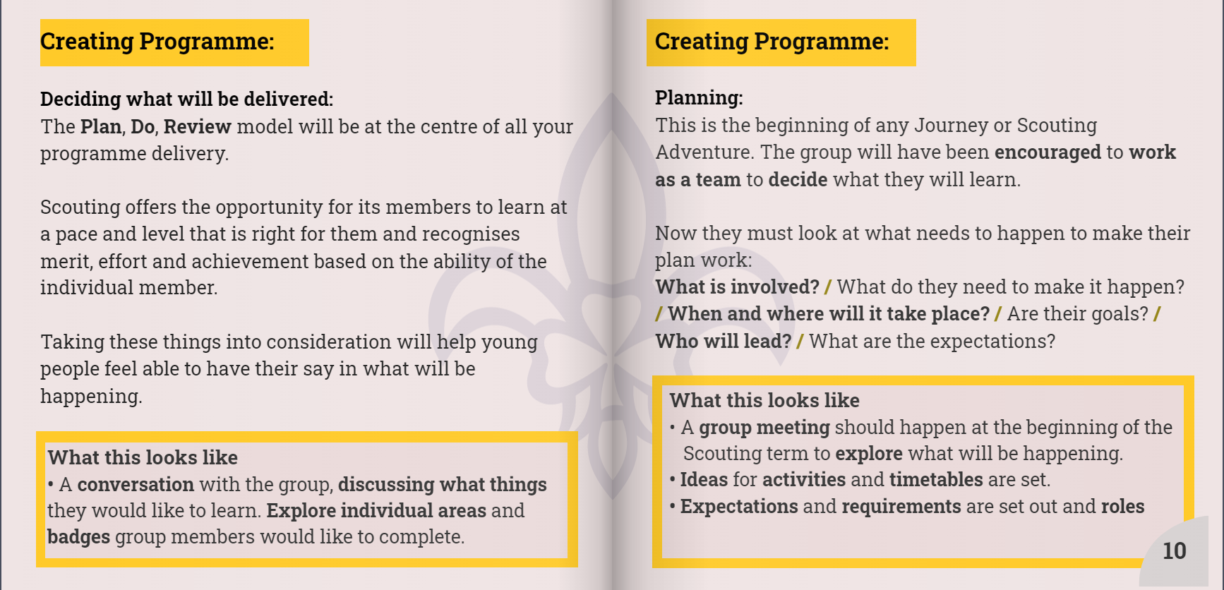
Creating Programme
Scouting Ireland Northern Province Conference 2023
Exploring Scout activities
Planning
Who does what?
?
Badges & Awards
Strengths
Hearing ideas & suggestions
Setting Goals
Timelines
Discussing realities
Leaders
How will it be done?
Expectations
Notes:
Creating Programme - Suggestions as read- Developed from See, Hear, Do resource

Slide 10
Delivering Programme
Scouting Ireland Northern Province Conference 2023
Explain roles
Breakdown activities
Teach new skills
?
One leader or many?
Affirm learning
Recognise effort
Learn by doing
Who does what & why?
Celebrate successes
What do they think?
How does this shape you?
Practice makes perfect
Notes:
Delivering Programme - Suggestions as read- Developed from See, Hear, Do resource

Slide 11
Reviewing Programme
Scouting Ireland Northern Province Conference 2023
Looking back
Reviewing
What didn’t work?
?
What worked well?
‘Check out’ conversation
Log Chews etc
Awarding badges
Personal achievement
Celebrate successes
Affirming new skills
What will we do next?
How would things be done differently?
Notes:
Reviewing Programme - Suggestions as read- Developed from See, Hear, Do resource

Slide 12
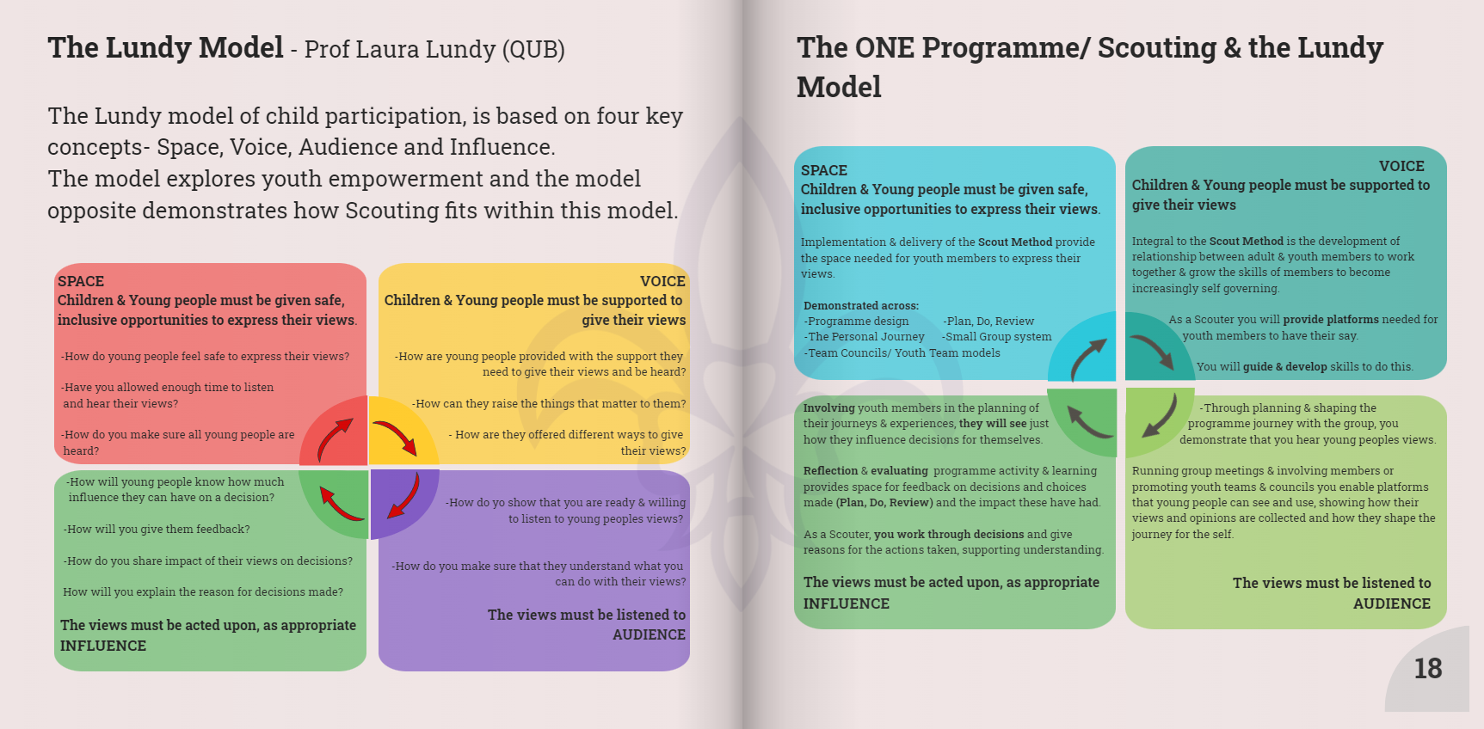
The Lundy Model(QUB) & Scouting Programme
Scouting Ireland Northern Province Conference 2023
Notes:
As already stated, empowering youth, growing the voice of young people to take control and ownership over their own experiences and learning has always sat at the core of what Scouting has intended to do.
The Lundy Model of Youth Empowerment was first developed around 2014, and in the subsequent years has been adopted widely across the globe by governments, councils, NGOs and other sectors working with young people to use as a framework to ensure that the voice and agency of young people to shape and control their own experiences is met.
Explain Lundy and mapping onto Scouting/ Programme delivery

Slide 13
Youth Team Model
Scouting Ireland Northern Province Conference 2023
An objective of the Programme Lead and ProgrammeTeam has been to look at the role and actions of Scouting in developing young people and giving them a voice.
In May 2022 a new ‘Northern Youth Team was established and guidance on developing ‘Group’ Youth Teams sent to all GLs.
The aim of these two things was:
To provide a platform at provincial level for young people to review and shape their Scouting experience.
To provide Groups with a new model to support capturing the voice of youth members.
Notes:
Click 1
Young people being heard at Board level, through the PMST via the Programme Lead and taking control over their own experiences through engaging with the Provincial planning day and being supported to deliver a new bursary developed by young people to support young people.
It also….Provided Groups a new model to support capturing the voice of youth members, demonstrating how youth led activity is used to shape the experience of the individual and the members.

Slide 14
Youth Team Model
Scouting Ireland Northern Province Conference 2023
How a Youth Team works and what it does…
Each Section nominates a rep and these reps meet about 4 x per year
Reps talk about their Sections experiences & plans and explore how as a Group they can do things collectively.
Scouters hear thoughts, listen to them and support plans brought forward.
Enables Scouters to reflect on the work they do and see how support they give grows young people.
Demonstrates how young people can have a say on what happens at higher levels.
Notes:
Click 1 - Representatives from each section should aim to meet at least once every 10 weeks for a 40 minute session including games’ activities and a discussion.
Click 2 - The Youth Team talks about all they have been doing in their Sections and looks at things they could do as a bigger group that are ‘joined up’.
Click 3 - Scouters hear their thoughts and ideas and help plan the things that should happen next either across Sections or the whole Group.
Click 4 –Scouters can reflect on and see how what they are doing supports youth members
&
Click 5 - ….and gives young people a space to see how their ideas can shape what happens at higher levels in the Group.

Slide 15
Youth Team Model
Scouting Ireland Northern Province Conference 2023
Where to next…
Groups can nominate Reps to sit on a County Youth Team.
Opportunities to meet with others from the County and look at collaborative activities.
Have a say in what Scouting looks like in the County…what’s working…what could be explored.
New skills in communication & representing others will lead to rep roles on Provincial and or National Youth Rep teams.
The full realisation of Youth Led/ Empowerment within the organisation achieved.
Notes:
Click 1 – From Group Youth Teams the next step is to nominate a rep to sit at the County level
Click 2 – This creates a space for Youth members to meet with their peers, identify with others and celebrate Scouting that is happening all around them.
Click 3 – This Team can plan for events and activities that the County can complete as a collective, it can also throw up ideas and new approaches to address the needs of youth members based on their current experiences…
Click 4 – The County team experience grows skills in participation, communication, working together and enables members to develop in their role as reps to sit at higher levels.
Click 5 – The ethos, aim and values of the organisation are achieved in being a youth led/ empowering organisation.

Slide 16
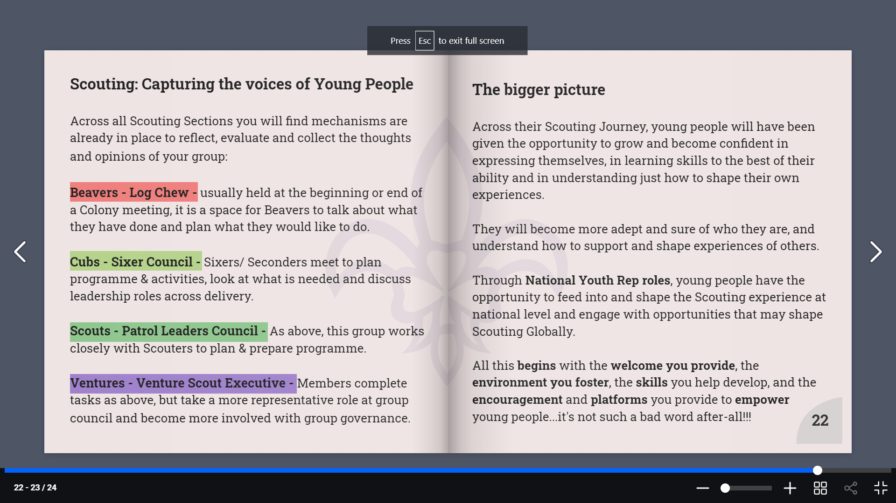
Linking it all up
Scouting Ireland Northern Province Conference 2023
Growing and empowering young people is something that we are all doing in every meeting, activity or adventure we have.
Running Log Chews, Sixer Councils etc or just ‘asking’ the opinion of our youth members leads to ‘empowering’ young people.
We develop the skills and knowledge needed to take control and make decisions.
Over all we ensure that young people have space to have a say and do what it is that they want to do.
This is Scouting…this is empowerment
Notes:
As is….

Slide 17
Thank you all…
Scouting Ireland Northern Province Conference 2023
Thanks for listening & being involved
If you have any questions or comments please just say…
Drew
The Hear, Say, Do resource has been developed by the Programme Lead, Programme Team and in consultation with the views and opinions expressed by members of the Northern Province Youth Team across Youth Team meetings & activities.
Notes:
As is….

